Slide 1
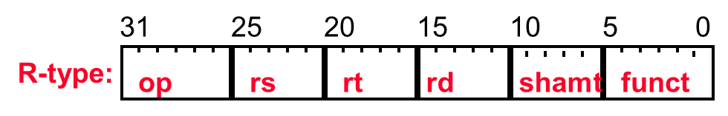
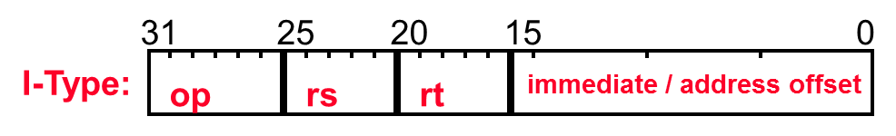
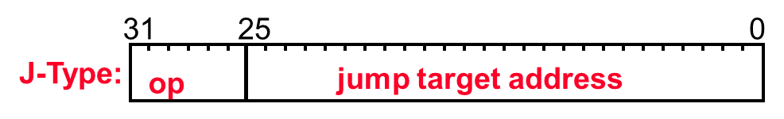
Single-Cycle/Non-Pipelined Datapath (Modify to Support 16 Instructions)
Instr[25-0]
1
Shift
left 2
28
32
0
26
0
PC_{inc}[31-28]
1
Add
0
PC_{inc}
jal
Add
1
4
J
Shift
left 2
BNE
BT
ALUControl
BEQ
Instr[31-26]
Control
Unit
Jr
MemtoReg
MemWrite
ALUSrc
Instr[5-0]
RegDst
RegWrite
ovf
Instr[25-21]
Read Addr 1
Instruction
Memory
Read
Data 1
Address
Instr[20-16]
Register
File
zero
Read Addr 2
Data
Memory
1
PC
Read
Address
Instr[31-0]
0
Read Data
0
Write Addr
ALU
0
1
1
Read
Data 2
0
0
Instr[15 -11]
Write Data
1
Write Data
1
11111
Instr[15-0]
Sign
Extend
16
32
Notes:
For lecture
Good exam questions
Add jalr rs,rd 0 rs 0 rd 0 9
jump to instr whose addr is in rs and save addr of next inst (PC+4) in rd
Add the PowerPC addressing modes of update addressing and indexed addressing (will have to expand the RegFile to be three read port and two write port)
Add andi, ori, addi - have to have both a signextend and a zeroextend and choose between the two, will have to augment the ALUop encoding (since can’t get the op information out of the funct bits as with R-type)
Add mult rs, rt with the result being left in hi|lo - so also include the mfhi and mflo instructions (will have to add a multiplier, the hi and lo registers and then a couple of muxes and their control).
Add barrel shifter

Slide 2
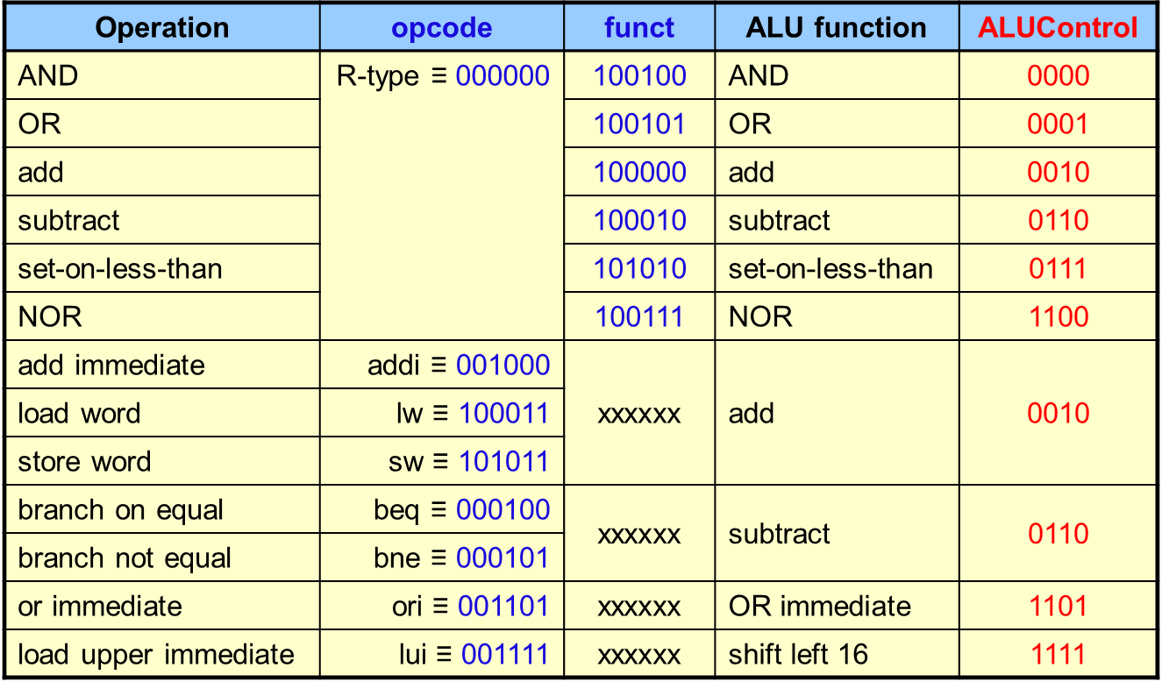
Extended ALU Control (Use This Table to Complete the CU Table)
ALUControl derived from opcode and funct
Combinational logic derives ALU control
opcode
rs
rt
rd
shamt
funct
31:26
25:21
20:16
15:11
10:6
5:0

Slide 3
Extended Control Unit (Modify to Support 16 Instructions)
opcode | funct | ALUControl | RegDst | ALUSrc | MemToReg | RegWr | MemWr | BEQ | J | BNE | Jal | Jr
R-type ≡ 000000 | AND 100100 | 0000 | 1 | 0 | 0 | 1 | 0 | 0 | 0 | 0 | 0 | 0
 | OR 100101 | 0001
 | add 100000 | 0010
 | sub 100010 | 0110
 | slt 101010 | 0111
 | NOR 100111 | 1100
 | jr 001000 | 1000 | 0 | 0 | 0 | 0 | 0 | 0 | 0 | 0 | 0 | 1
lw ≡ 100011 | xxxxxx | 0010 | 0 | 1 | 1 | 1 | 0 | 0 | 0 | 0 | 0 | 0
sw ≡ 101011 | xxxxxx | 0010 | 0 | 1 | 0 | 0 | 1 | 0 | 0 | 0 | 0 | 0
beq ≡ 000100 | xxxxxx | 0110 | 0 | 0 | 0 | 0 | 0 | 1 | 0 | 0 | 0 | 0
j ≡ 000010 | xxxxxx | 0000 | 0 | 0 | 0 | 0 | 0 | 0 | 1 | 0 | 0 | 0
addi ≡ 001000 | xxxxxx | 0010 | 0 | 1 | 0 | 1 | 0 | 0 | 0 | 0 | 0 | 0
bne ≡ 000101 | xxxxxx | 0110 | 0 | 0 | 0 | 0 | 0 | 0 | 0 | 1 | 0 | 0
jal ≡ 000011 | xxxxxx | 0011 | 0 | 0 | 0 | 1 | 0 | 0 | 0 | 0 | 1 | 0
ori ≡ 001101 | xxxxxx | 1101 | 0 | 1 | 0 | 1 | 0 | 0 | 0 | 0 | 0 | 0
lui ≡ 001111 | xxxxxx | 1111 | 0 | 1 | 0 | 1 | 0 | 0 | 0 | 0 | 0 | 0
Notes:
For class handout

